Slide 1



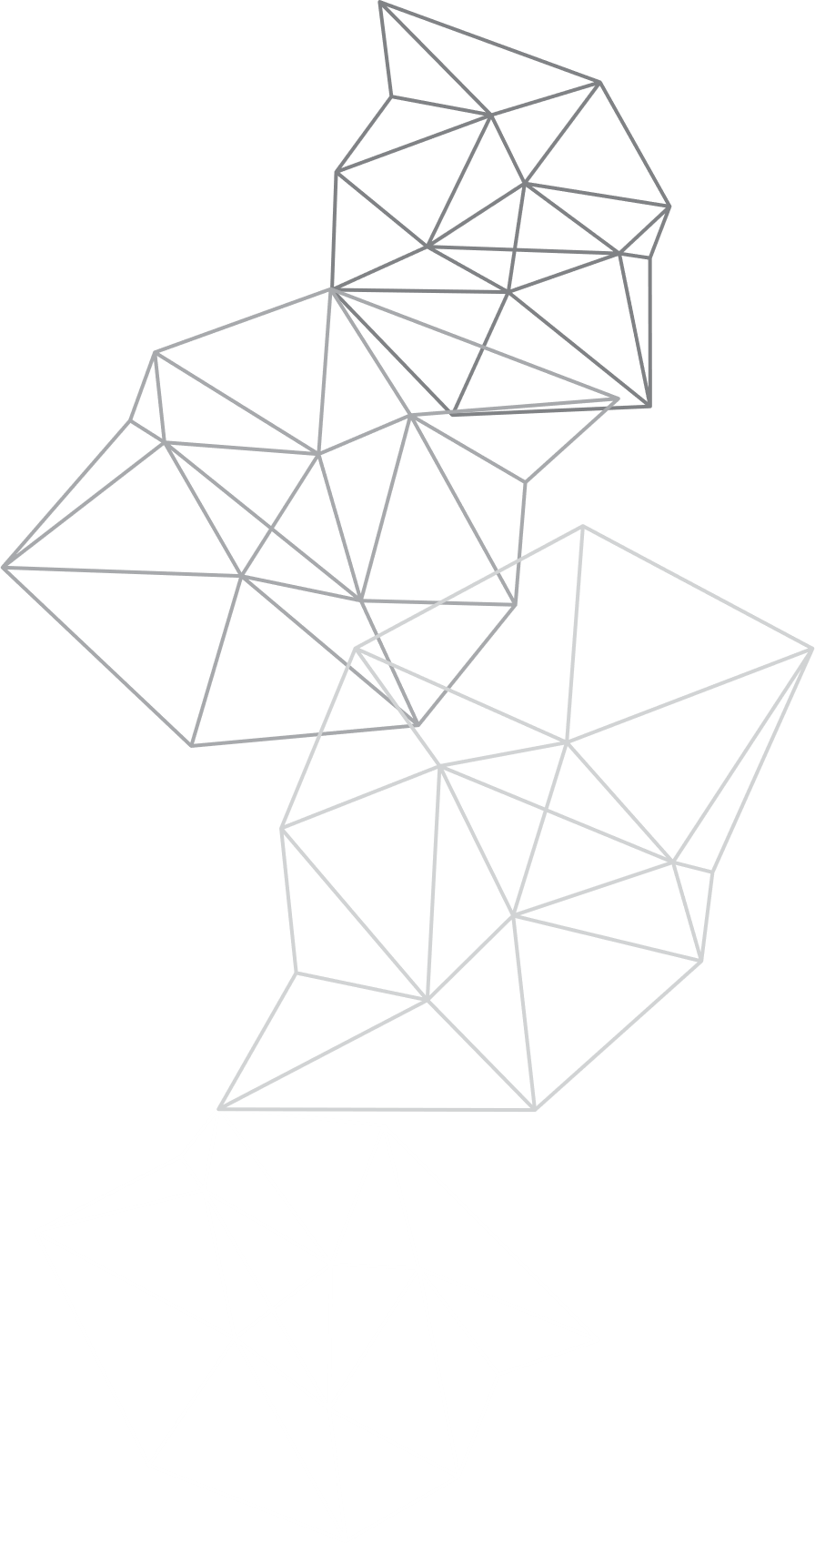


R.D.ENGINEERING COLLEGE
DEPARTMENT OF COMPUTER SCIENCE & ENGINEERING (CSE & ALLIED)
PROJECT PRESENTATION
Title: Color and Object Detection System
GROUP No. :- RD24CSE702 GUIDE NAME:- Mr. Lav Dixit sir
PROJECT GROUP DETAILS:-
HARSH TYAGI (2102311530027)
YASH TYAGI (2102311530059)
VARSHA (2102311530056)
SAKSHI BHARDWAJ (2102311530045)

Slide 2

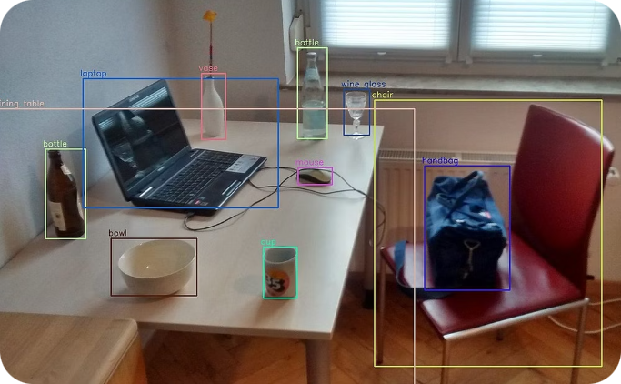
PROBLEM STATEMENT
The existing systems for real-time color and object detection face several challenges and limitations that can hinder their effectiveness and reliability. Here are some of the key problems associated with these systems
Lighting Variability
Color Similarity
Real-Time Processing Limitations
Scalability & Cost
Object Detection using Color estimation

Slide 3


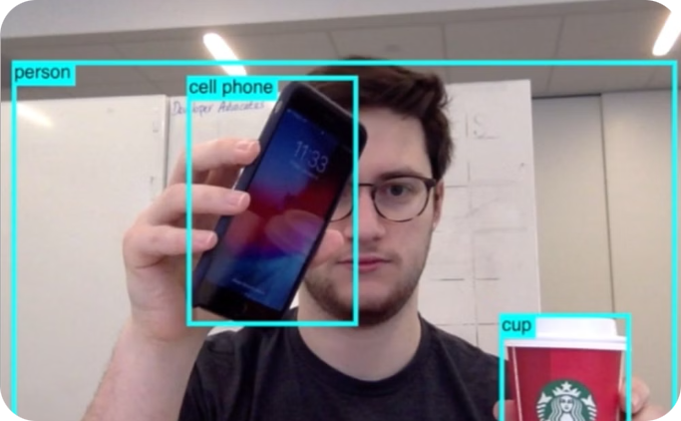
Integration of Advance Technologies in key
to addressing long lasting challenges such as:
Color Variability
Background Interference
Transparency
Real-Time Processing
AIM : This project aims to develop a system capable of detecting both the color and objects present in an image. This system will leverage advanced computer vision techniques and machine learning algorithms to achieve accurate and efficient results.
INTRODUCTION

Slide 4
PROJECT OVERVIEW
The system processes video frames in real-time, providing immediate feedback on detected objects.
It identifies objects based on specific color attributes, allowing for targeted detection.
The system can track the movement of detected objects across frames.
The system can be trained to recognize new colors and objects based on user input.
A graphical user interface (GUI) for easy interaction and parameter adjustment.
Users can define target colors and objects, making the system adaptable to various scenarios.

Slide 5
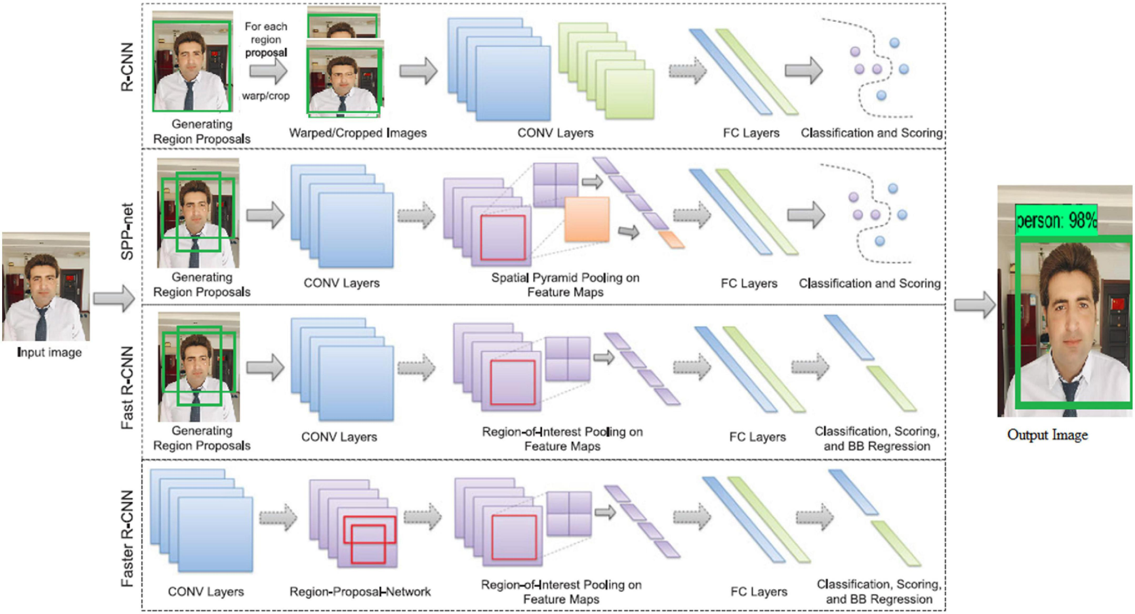
EXSISTING SYSTEM
Case Studies/Real-World Examples:
Color-Based Object Recognition: Research in this area explores techniques for identifying objects based on their color characteristics. These methods leverage color histograms, color spaces, and other color-based features to distinguish objects from their surroundings.
Object Recognition Using Deep Learning: Deep learning approaches are widely used for object recognition. Convolutional Neural Networks (CNNs) are particularly effective in learning complex patterns and features from images, enabling them to identify objects with high accuracy.
Color and Object Detection in Real-World: Research investigates the integration of color and object detection techniques in real-world applications, such as autonomous driving, robotics, and medical imaging. This research focuses on improving the accuracy, robustness, and efficiency of these systems in diverse environments.

Slide 6

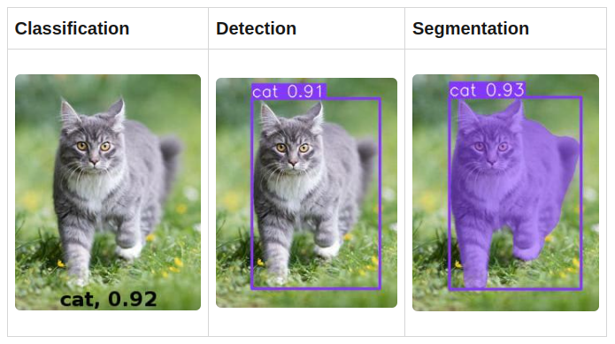
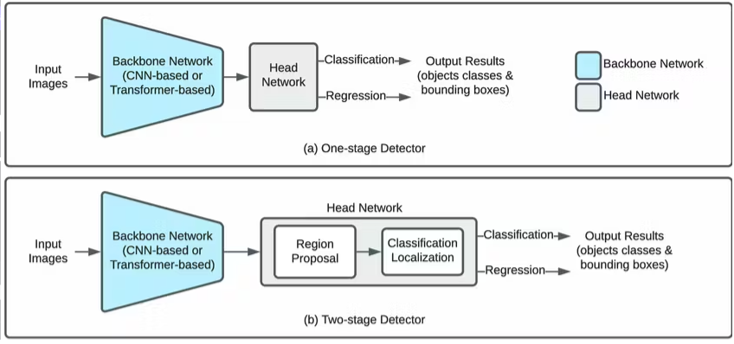
How does it works?

Slide 7
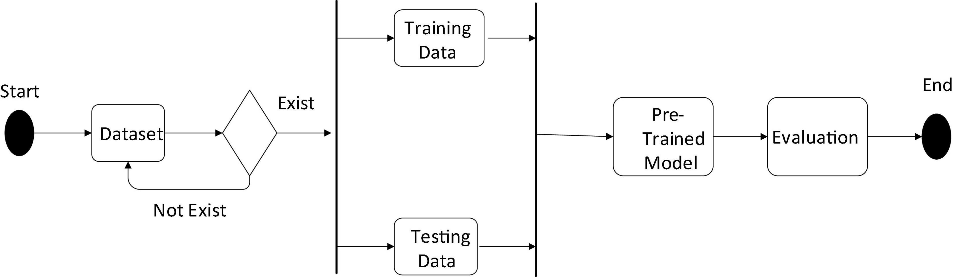
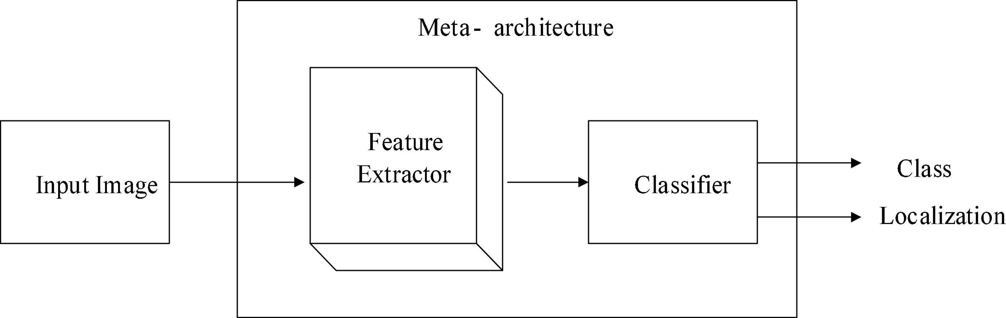
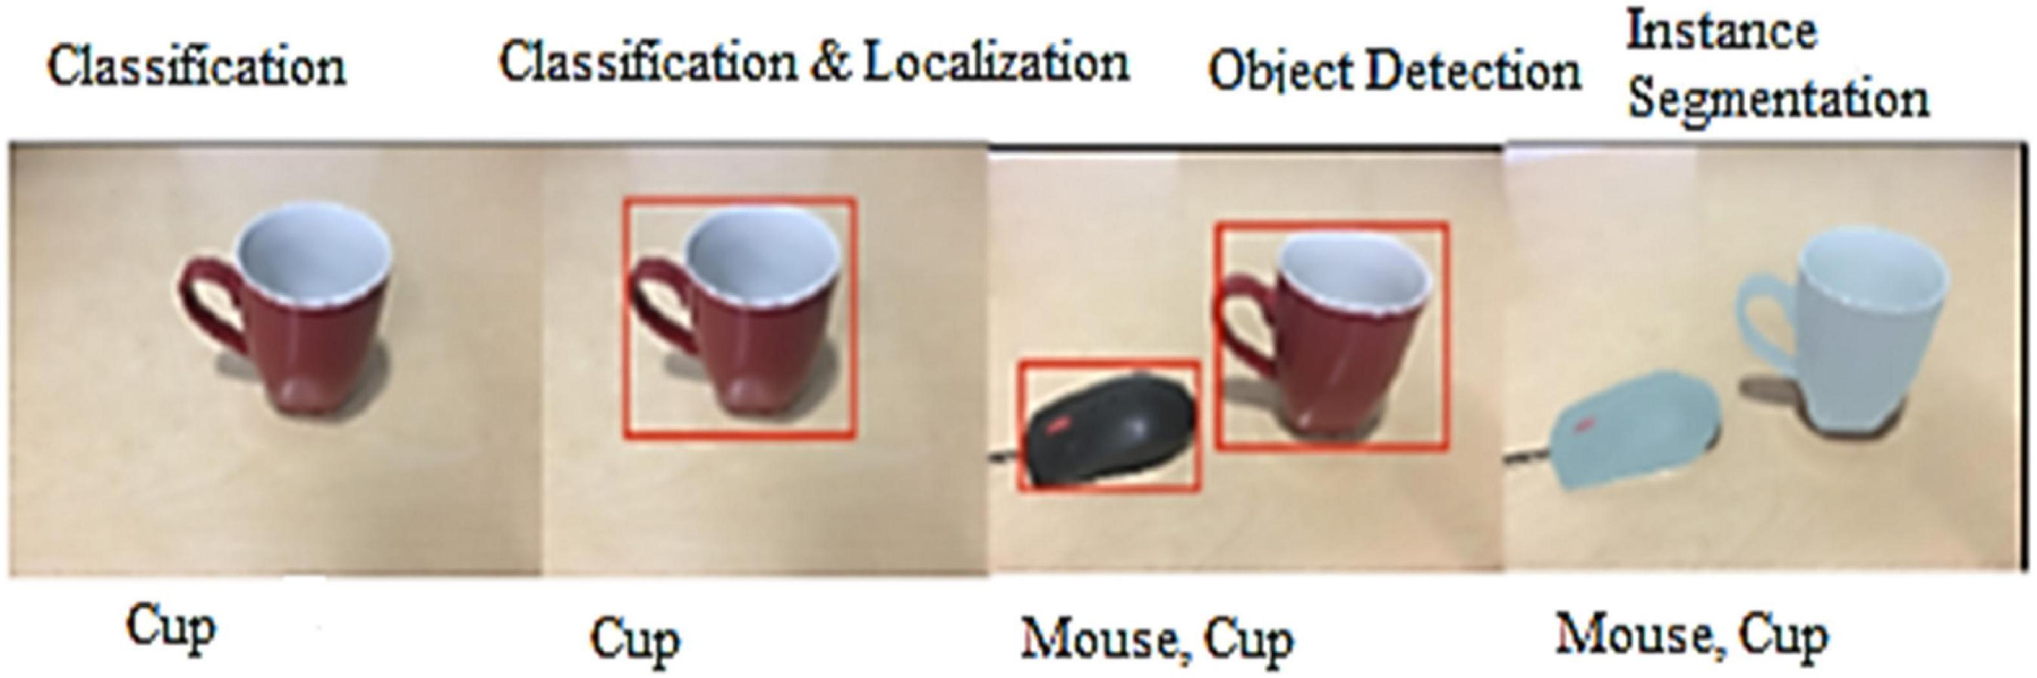
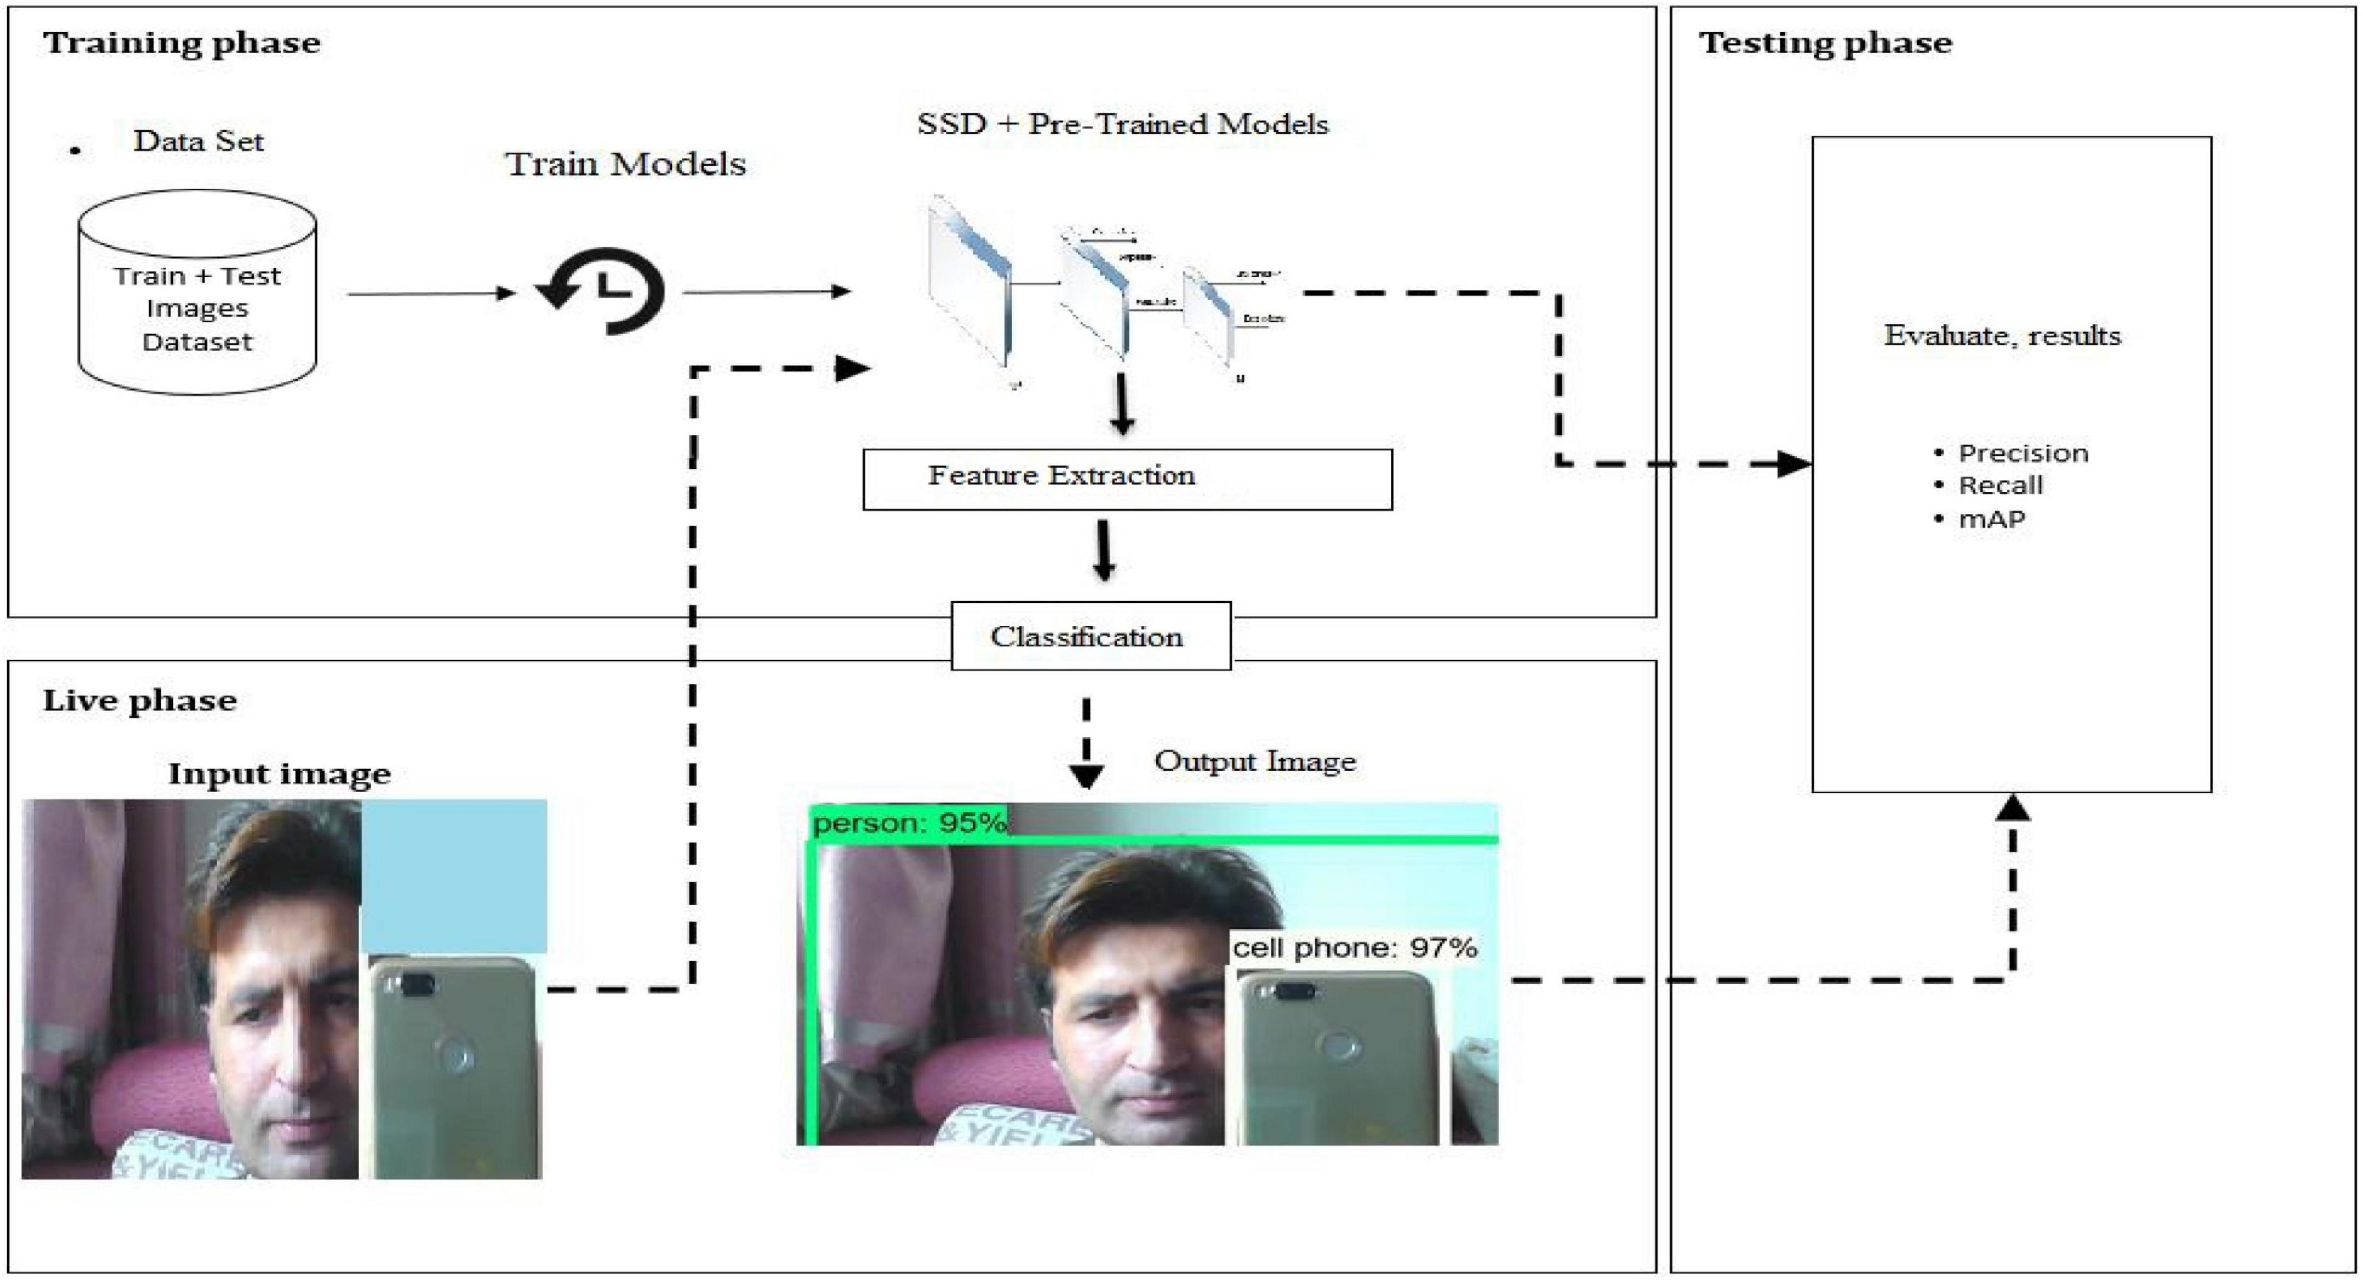
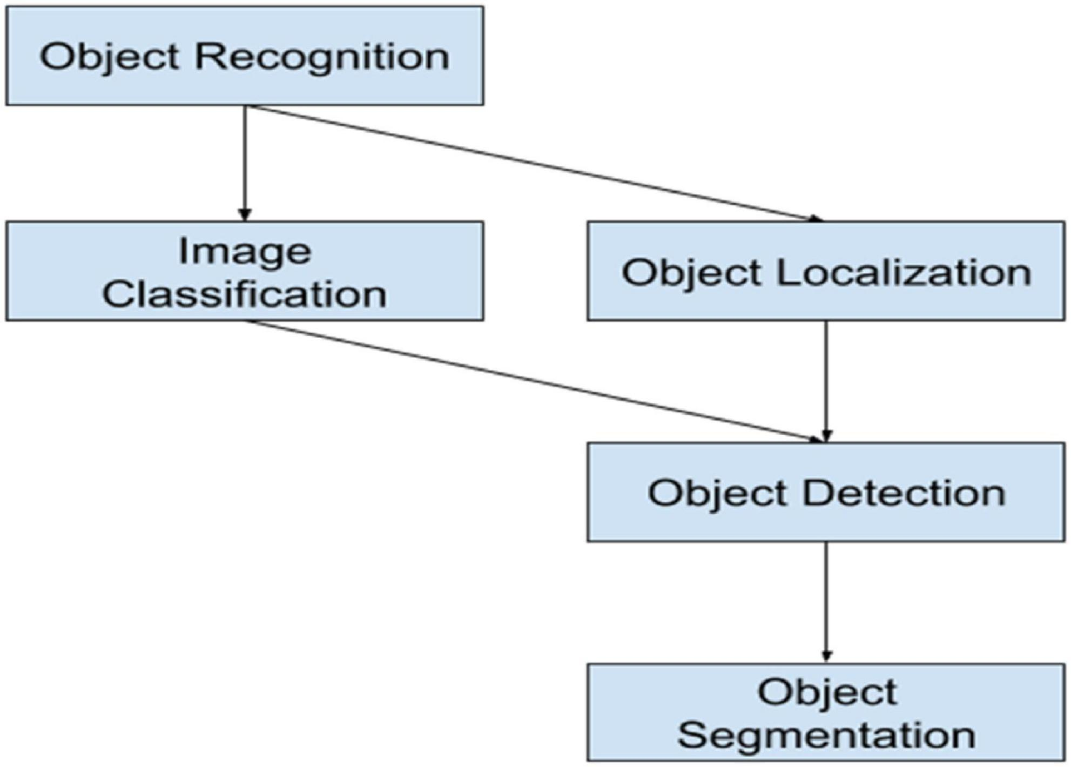

Slide 8
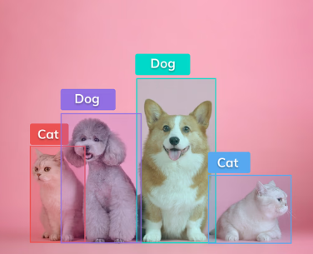
Latest technologies used
Color and Object Detection System:
Python – It is the primary programming language used for this project. Its versatility and extensive libraries make it ideal for developing computer vision applications.
OpenCV – Supports multiple programming languages and platforms, making it versatile for developers.
Numpy - : A fundamental library for numerical computation, providing support for multi-dimensional arrays and mathematical operations essential for image manipulation.
Tkinter: A standard Python GUI toolkit, enabling the creation of user interfaces for interacting with the object detection system.

Slide 9



